Slide 1


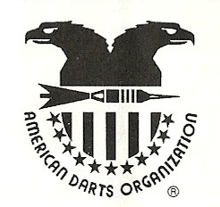

Stooges Bar
The All-Capital $1000+ Tournament
Saturday, June 4, 2011
 | Mix Trips | Men’s Singles | Women’s Singles | Men’s Doubles | Women’s Doubles | Blind Draw
 | 701 | 01, Cricket, Choice | 01, Cricket, Choice | 01, Cricket, Choice | 01, Cricket, Choice | 01, Cricket, Choice
1st | 120 | 100 | 57 | 90 | 60 | 80
2nd | 60 | 50 | 28 | 50 | 30 | 50
3rd | 30 | 25 | 20 | 32 | 20 | 30
4th |  | 12 | 12 | 24 |  | 20
Totals | 210 | 187 | 117 | 196 | 110 | 180
Come on down and see us at:
Semifinal losers will play for 3rd place!
Doors open at 11am; Darts fly at Noon!
$12 Entry Fee for Singles
$10 Entry Fee for all other events
932 Noe Bixby Road
Columbus, OH 43232
http://www.facebook.com/columbusdartersassociation

