Slide 1

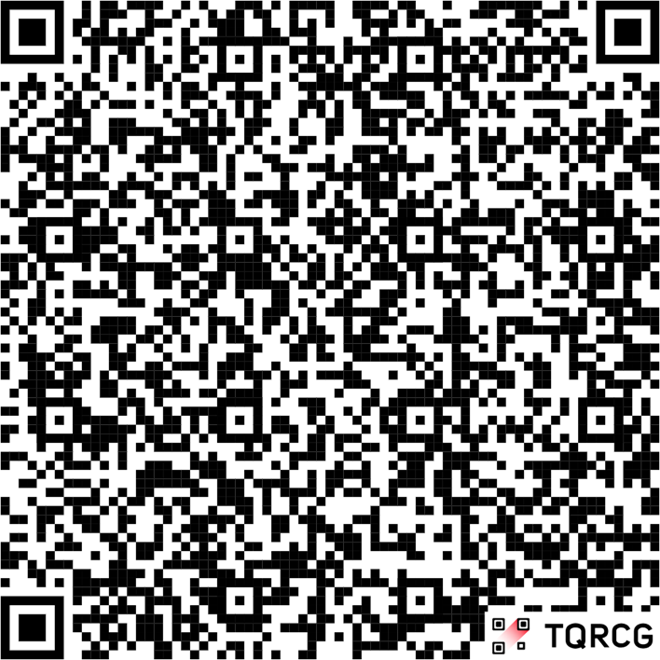




$6000
www.wyndhamhotels.com/hotels/55195?checkindate=01/08/2026&checkoutdate=01/11/2026&groupcode=010826WDA
44th Annual
Air Capital Open
Wyndham Suites by Hawthorn
5500 W Kellogg Dr
Wichita, Ks 67209
316-943-2181
Link for darters rate found at
https://wdanews.com
January 9-11,2026
Day/ Time | Friday 12:00pm | Friday 7:00pm | Friday 8:30pm | Saturday 10:30am | Saturday 11:00am | Saturday 1:00pm | Saturday 1:30pm | Saturday 5:30pm | Sunday 11:00am | Sunday 11:30am | Sunday 1:00pm | Sunday 1:30pm
Sign ups open | 11:00am | 5:30pm | 7:00pm | 9:30am | 10:00am | 12:00pm | 12:30pm | 4:30pm | 10:00am | 10:30am | 12:00pm | 12:30pm
Event | ADO National Qualifer | Mixed Doubles 501/Cricket | Chicago Draw | Open Doubles Cricket | Womens Singles 501## | Open Singles 501## | Womens Doubles Cricket | Mixed Triples 601 | Open Doubles 501 | Womens Singles Cricket | Open Singles Cricket | Womens Doubles 501
Fee | $75 Per Player | $30 Per Team | $10 Per Player | $30 Per Team | $20 Per Player* | $20 Per Player* | $30 Per Team | $45 Per Team | $30 Per Team | $20 Per Player* | $20 Per Player* | $30 Per Team
1st | Masters National Qualifer | $180 | $220 | $220 | $150 | $300 | $290 | $540 | $200 | $140 | $200 | $140
2nd |  | $90 | $110 | $110 | $75 | $125 | $130 | $240 | $100 | $60 | $100 | $80
3-4 |  | $50 | $60 | $60 | $40 | $60 | $60 | $120 | $50 | $30 | $50 | $40
5-8 |  | $30 | $30 | $30 |  | $30 |  | $60 | $30 |  | $30
Totals |  | $490 | $570 | $570 | $305 | $665 | $540 | $1260 | $520 | $260 | $520 | $300
AMATEUR STATUS: The host association and/or the ADO assumes no responsibility for any adverse effects which
Dart awards may have on the amateur status of any Youth Participant. Please check local regulations/restrictions.
Warning: Darts are an adult sport. It is dangerous for children to play without adult supervision.
## 501 singles will be alternating start and best of 5 until the finals which will be best of 7 for Ladies and best of 9 for Open
All other events will be best of 3 legs until the finals which will be best of 5 and cork every leg
*Includes $2 ADO Surcharge
PLEASE DO NOT BRING OUTSIDE FOOD OR BEVERAGES INTO THE DART HALL!
ALL SIGN UPS CLOSE 15 MINUTES PRIOR TO START
Tournament director
Brian Roeder
316-516-3876
For more information contact
Vince Oliver
316-641-3722
kooluof@cox.net

